Slide 1
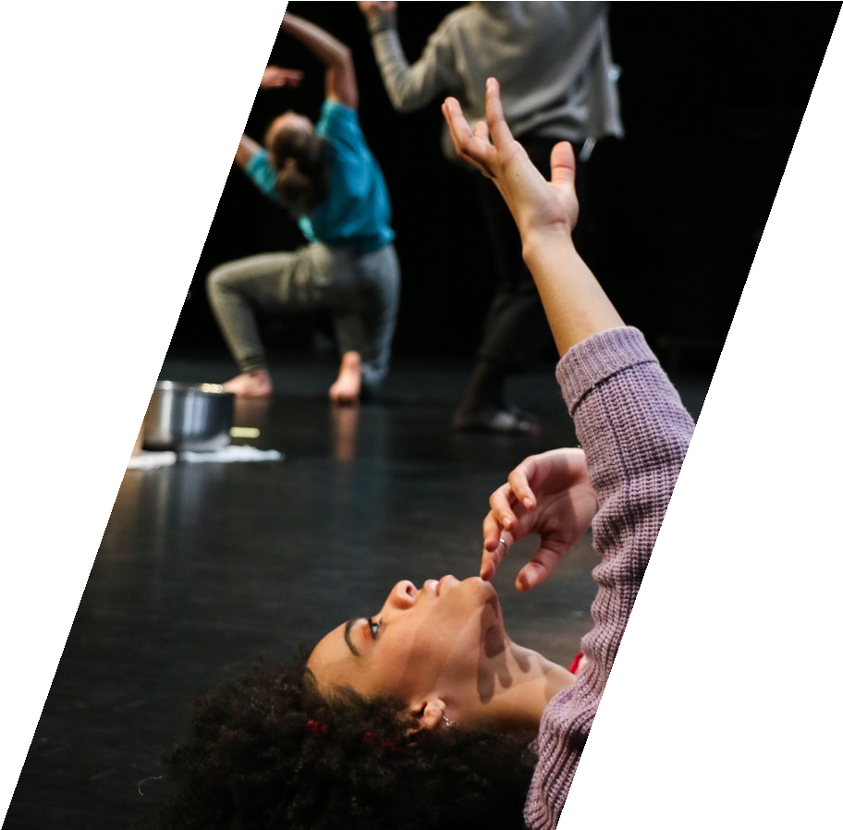
Oasis XR
Mixed Reality Performance created by Professor Zuniga Shaw with composer Byron Au Yong. Integrating physical and virtual experience, Oasis offers a soft space for turning to toward the issues at hand.
Oasis ecologies and warm water flow through the themes of the work as does mirage and the impermanence of any site of refuge on the planet today.

Slide 2
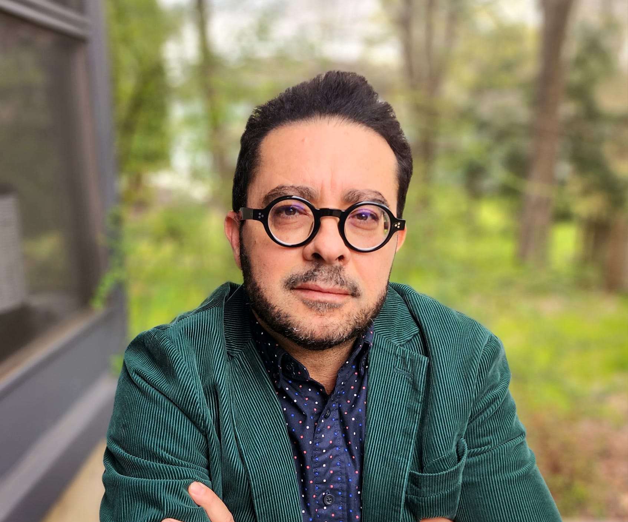
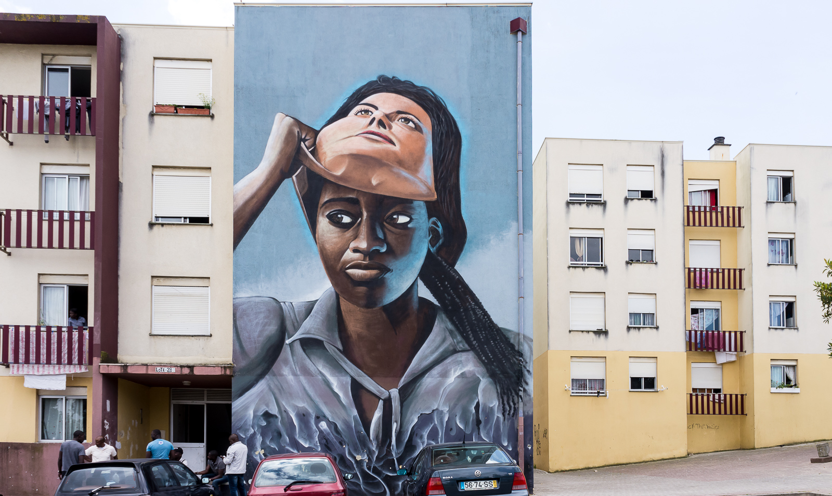
Black Subjectivities in Portuguese Literature,
1840s-2020s
This project, which includes an ongoing monograph, journal articles, conference presentations and a graduate seminar, traces the formation and appropriation of Black subjectivities in literary writings by white and Black authors alike, from the formation of the Portuguese literary canon from during Romanticism to our time. Particular attention is paid to the convoluted dialectics of ventriloquism and authorship at play across a panoply of genres, authors, and aesthetic movements.
Pedro Schacht Pereira
Department of Spanish and Portuguese
(Image credit: mural art by Nomen)

Slide 3
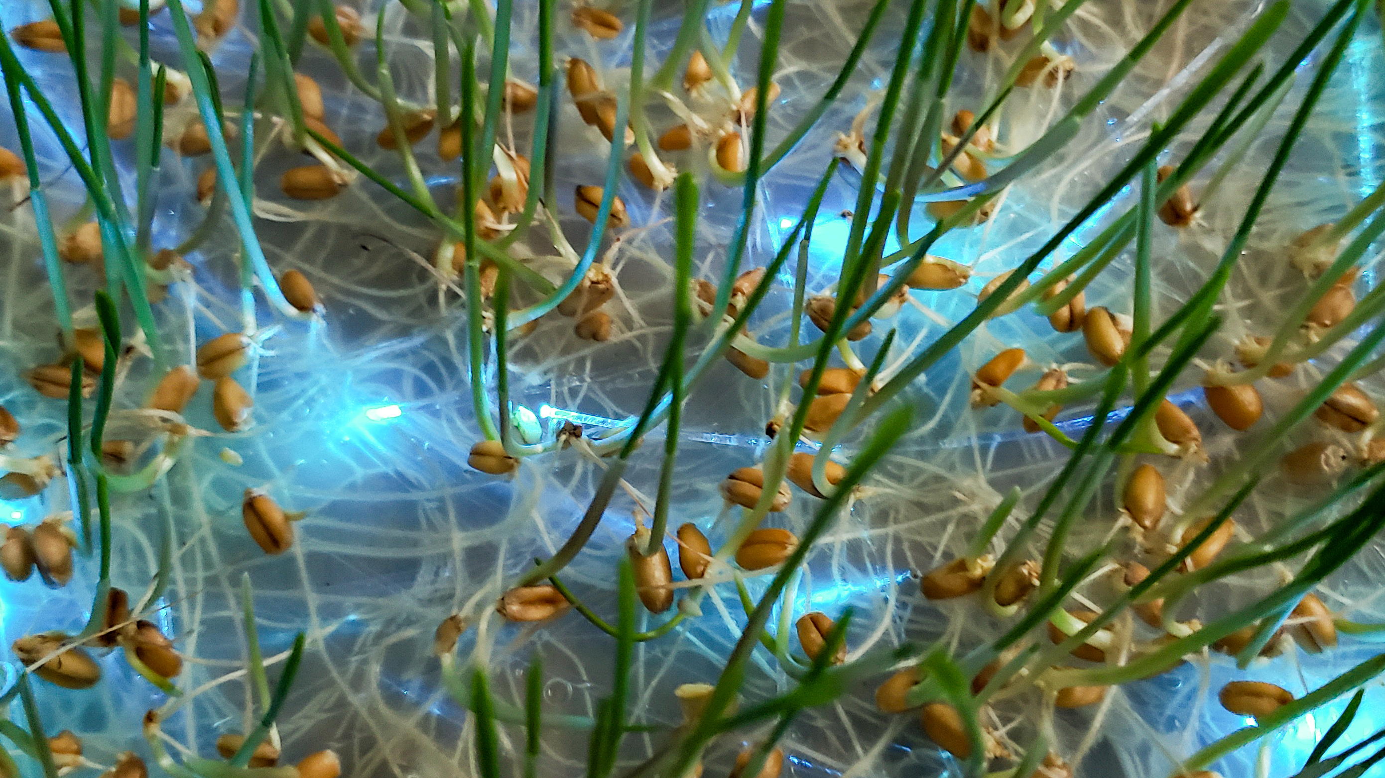
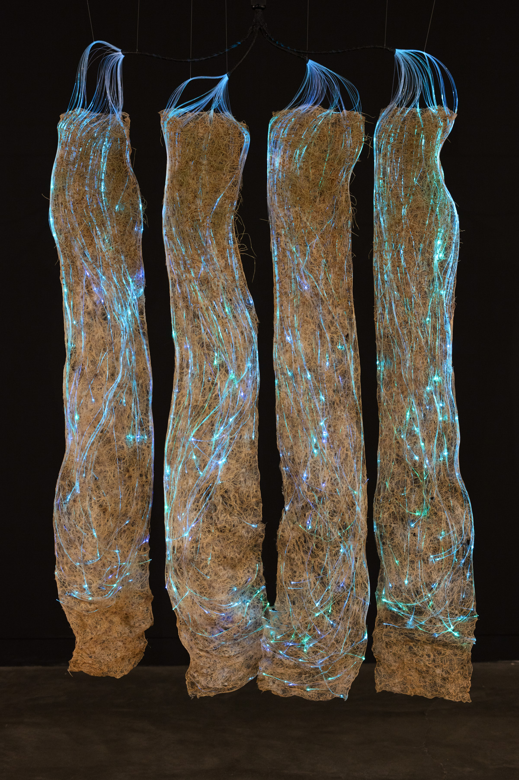
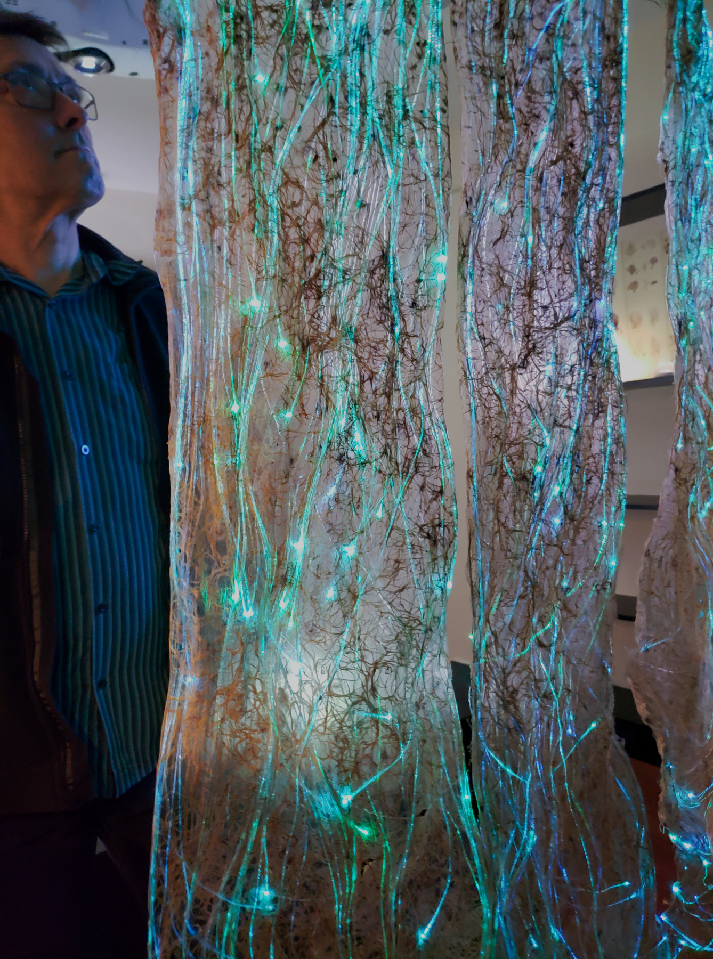
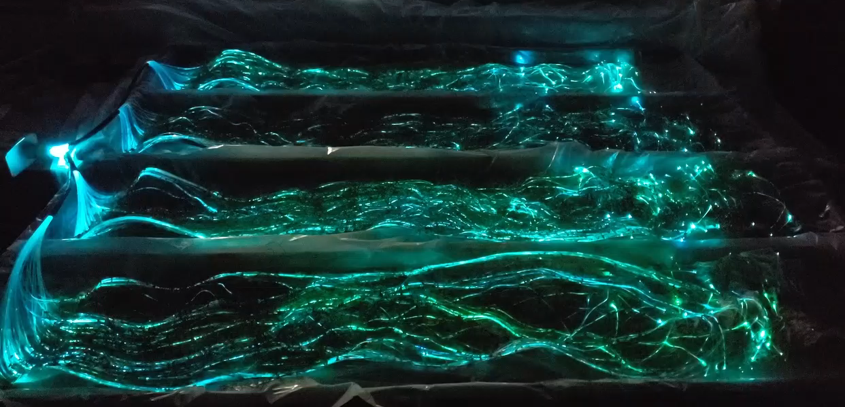
Roots Weaving Waves
Amy M. Youngs, Associate Professor of Art
An artwork woven by plant roots. Wheatgrass seeds are sown into a bed of agar agar, where their roots weave into strands of fiber optic cables.
Exhibited: Spring 2022 at the Cameron Art Museum, Wilmington, NC.

Slide 4


Slide 5
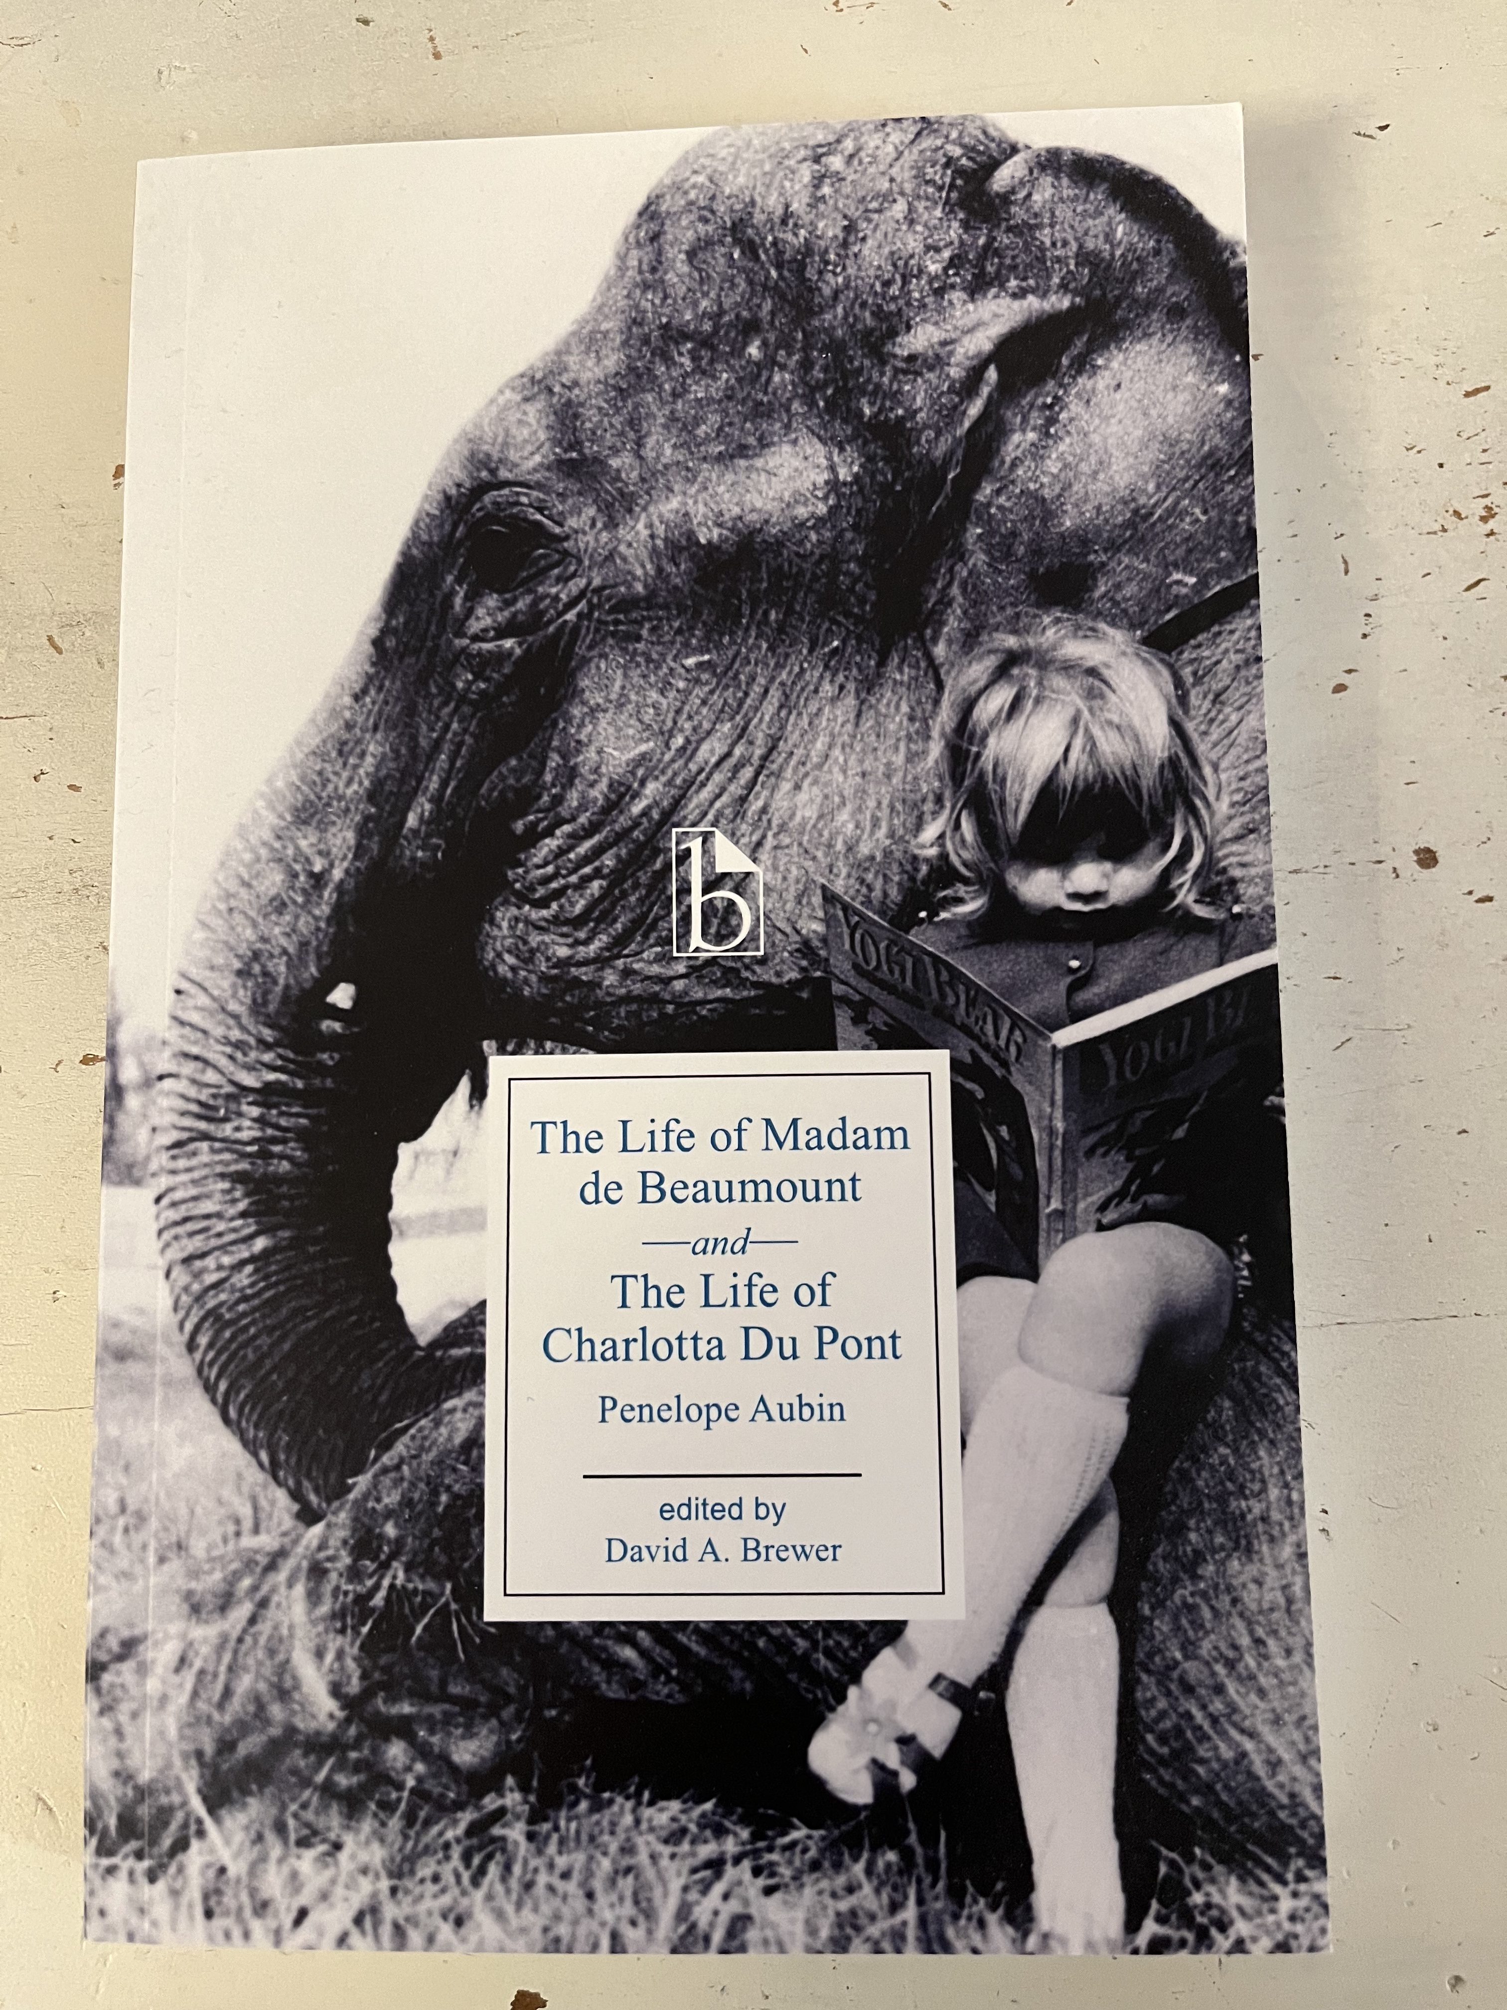
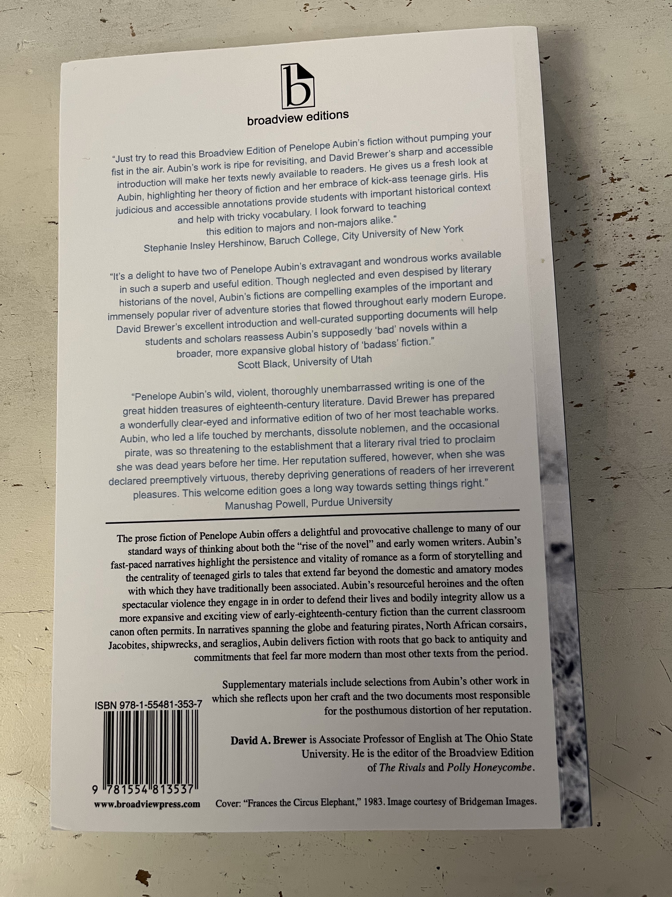
My Autumn 2022 course release allowed me the time to complete my edition of two of Penelope Aubin’s wild romances from the 1720s and get it into production

Slide 6
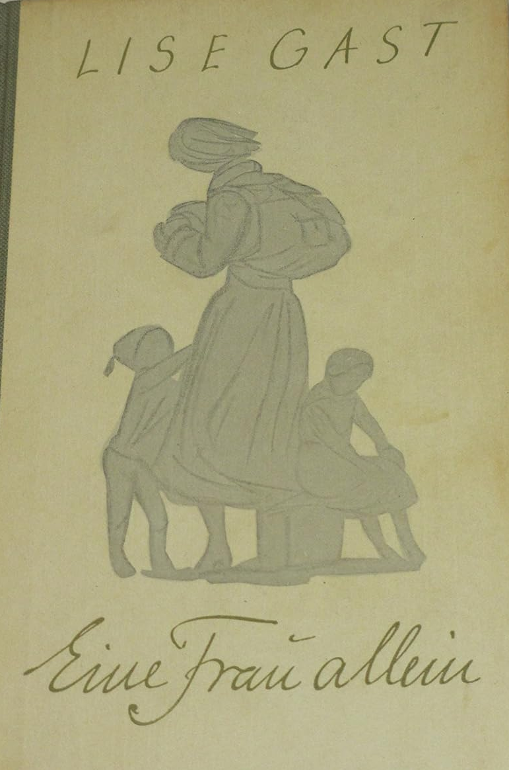
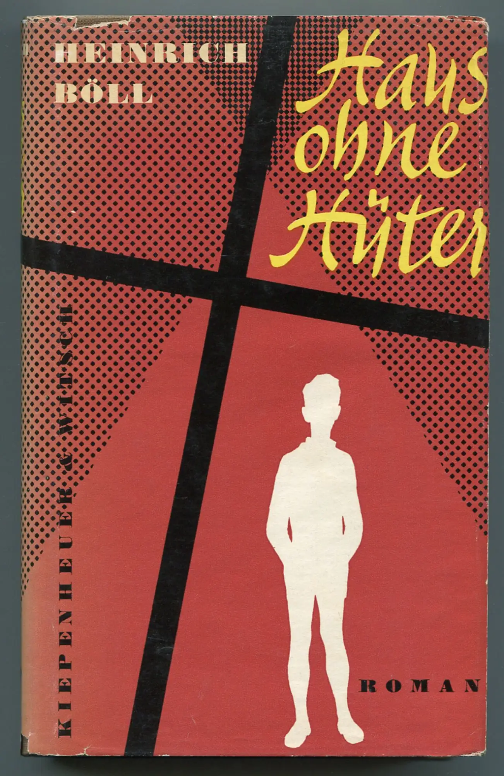
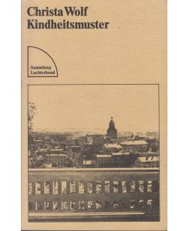
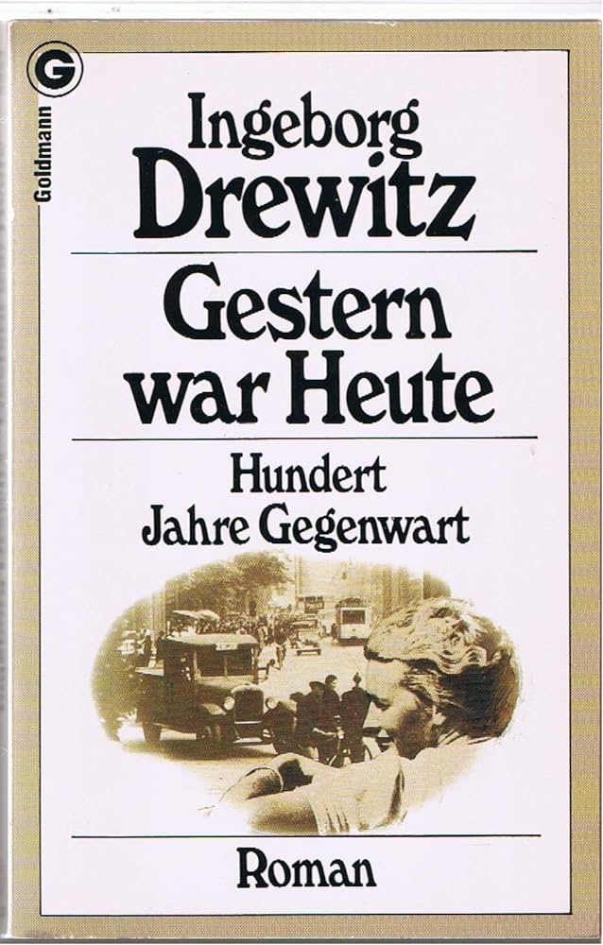
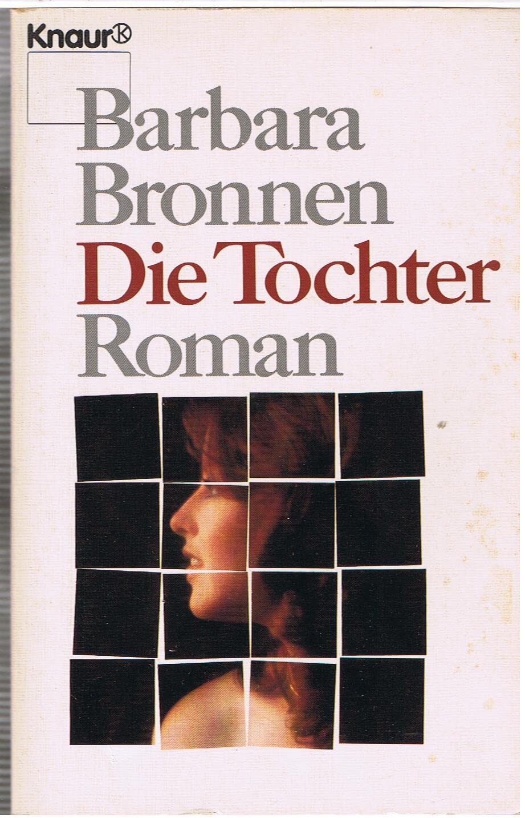
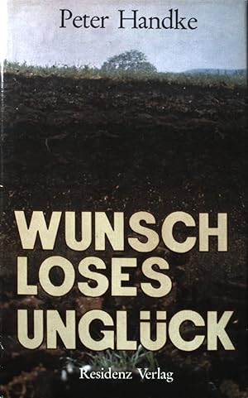





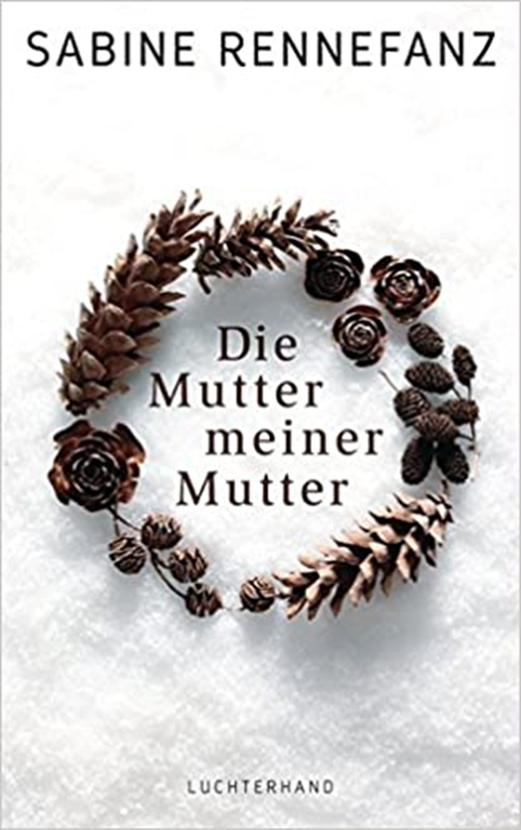

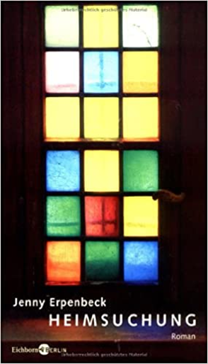


Remembering Mother:
The Evolution of Memory in Postwar Germany
This monograph illuminates how genre links gender and memory by examining German-language memoirs and novels about World War II-era mothers and grandmothers. Tracing the evolution of family novels written between 1948 and 2018, it contends that analyzing genre provides a way to track the interlocking dynamics of gender and collective memory through time.
As it does, it upends the common generational account of postwar German memory culture. Contemporary family novels display features common in books about mothers from the 1950s forward, as well as in female-coded genres. The book thus contends that the change in public memory culture that took place in Germany around 2000 can be viewed as a gendered shift, rather than a generational one. In the last twenty years, what was once seen as women’s memory has become German memory.
Katra Byram, Associate Professor,
Germanic Languages and Literatures

Slide 7

Shakespeare in the “Post”Colonies
Amrita Dhar and
Adélékè Adéèkó
Department of English
https://shakespearepostcolonies.osu.edu
OPEN-ACCESS DIGITAL INTERVIEWS WITH LEADING POSTCOLONIAL SHAKESPEAREAN CREATIVES
FROM AROUND THE WORLD

Slide 8

Book: Seed Money: Monsanto’s Past and Our Food Future
Bart Elmore
Professor of Environmental History
Department of History

Slide 9
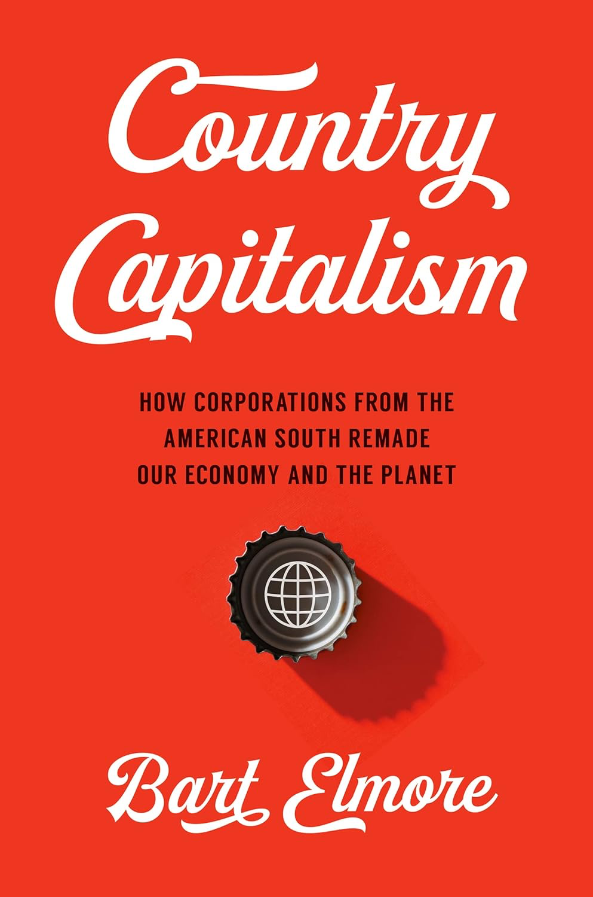
Book: Country Capitalism: How Corporations from the American South Remade Our
Bart Elmore
Professor of Environmental History
Department of History

Slide 10


Slide 11
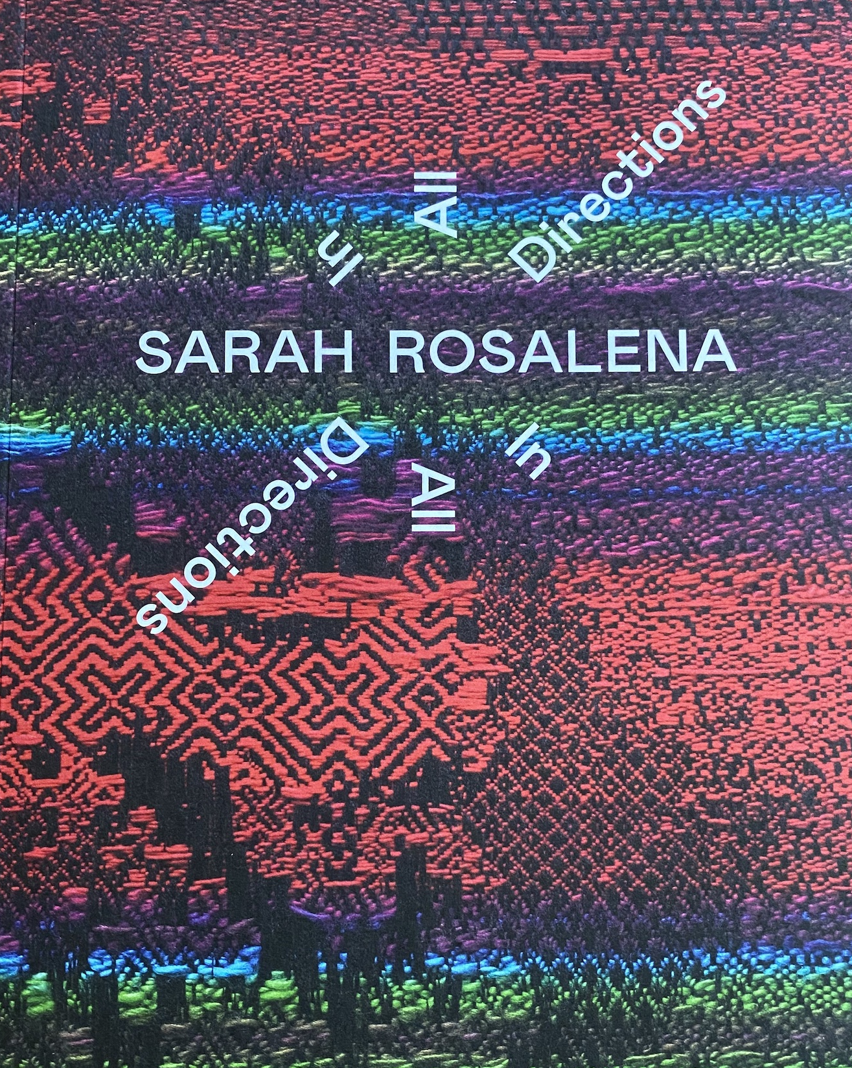
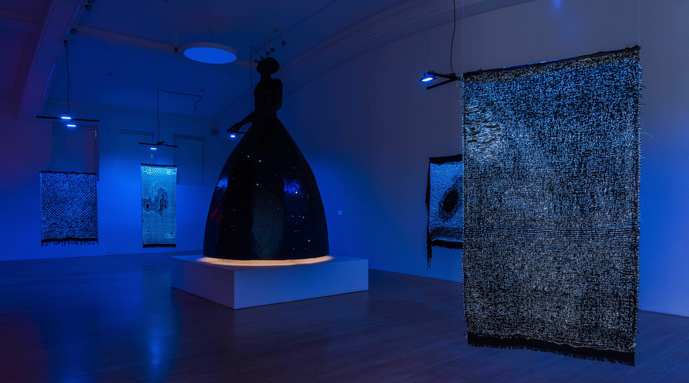
Sarah Rosalena: In All Directions at the Columbus Museum of Art. Museum exhibition organized by Prof. Kris Paulsen and History of Art students, accompanied by a catalogue with writing by the students and Kathryn Yusoff and Elizabeth Povinelli. September 8, 2023 – February 4, 2024.

Slide 12
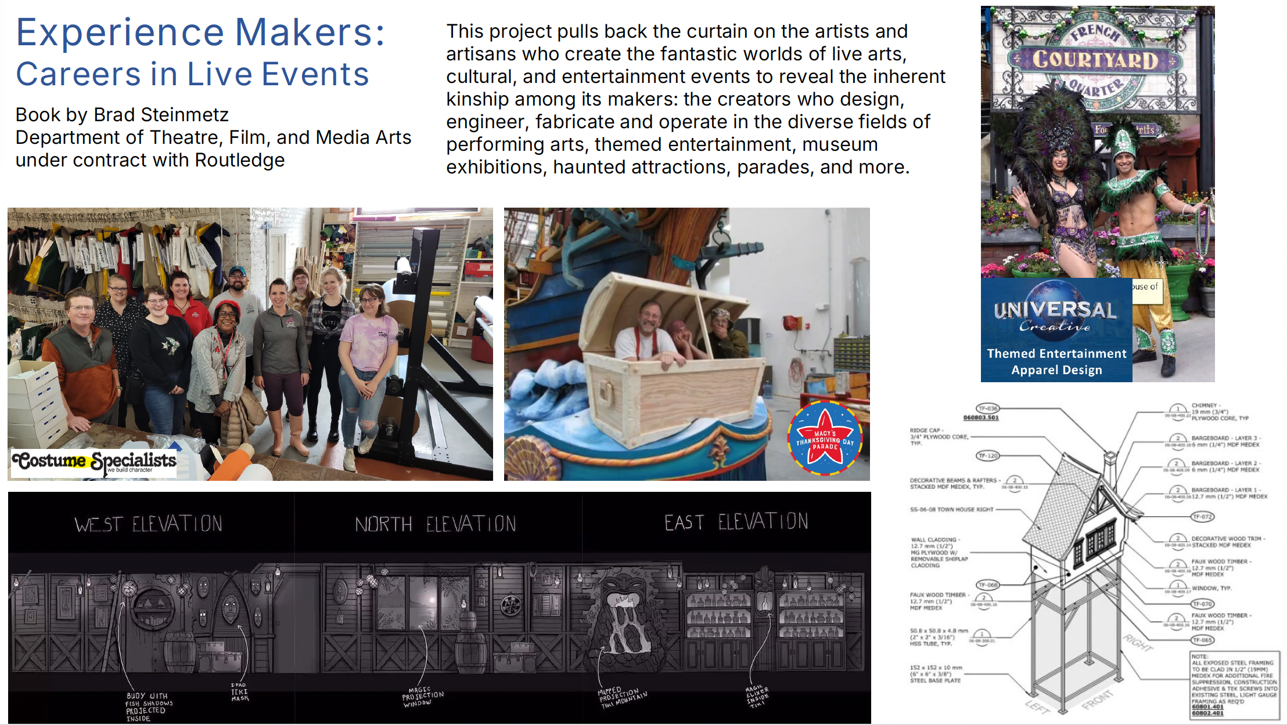

Slide 13

Jennifer Suchland WGSS & SEELC
Storytelling excessive punishment from the perspective of people who are directly impacted.
Collaboration + Community Engagement + Social Transformation

Slide 14
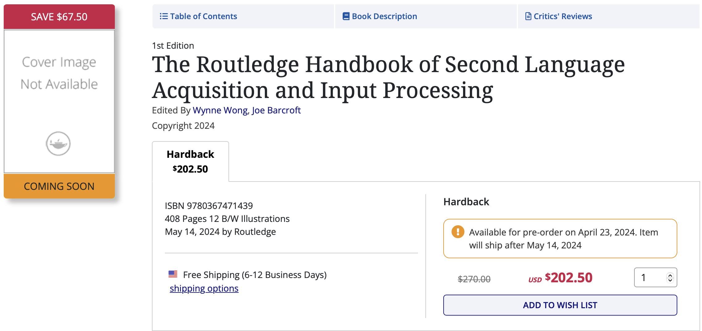
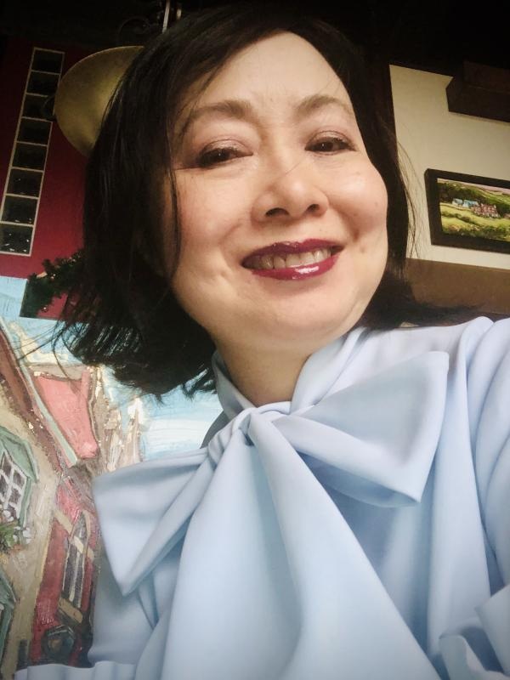
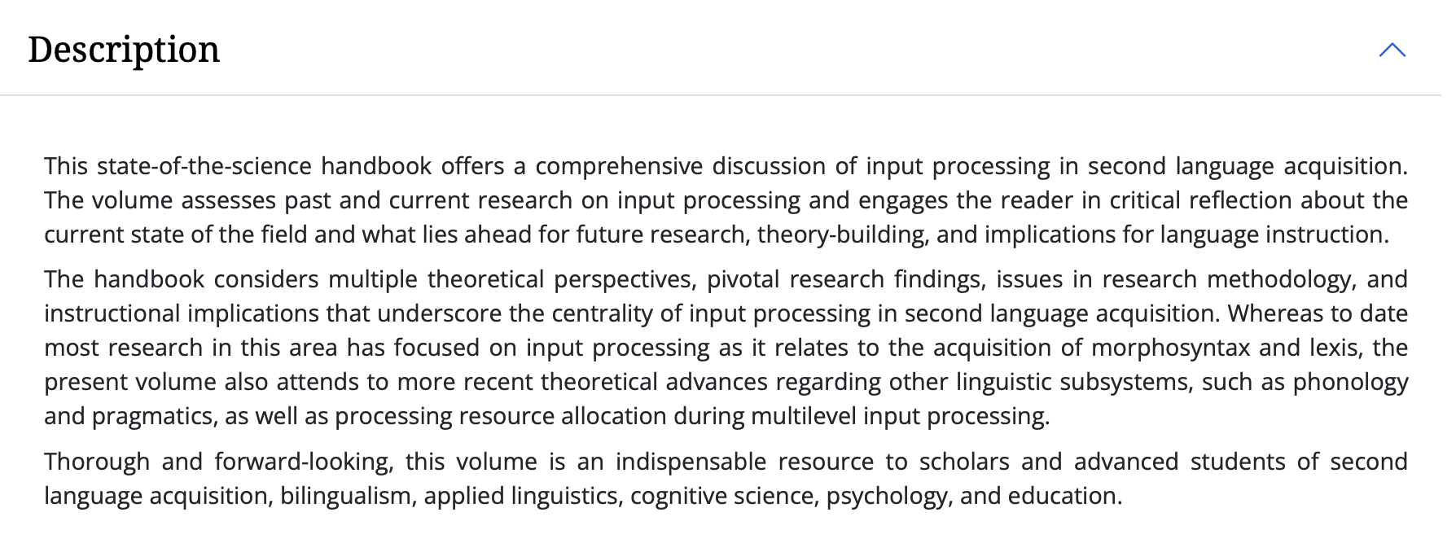
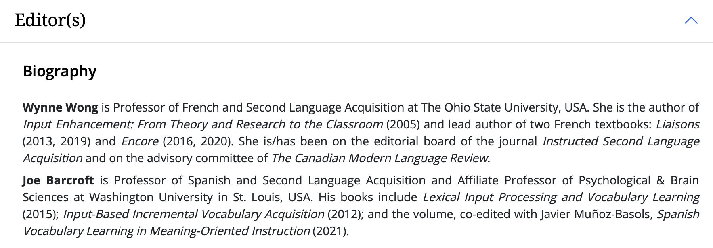
Wynne Wong
Department of French & Italian
Professor of French & Second Language Acquisition

